Slide 1

Excel Final Assesment
Danduprolu Stuthi
4273 - LVADSUSR80
28-02-2024

Slide 2
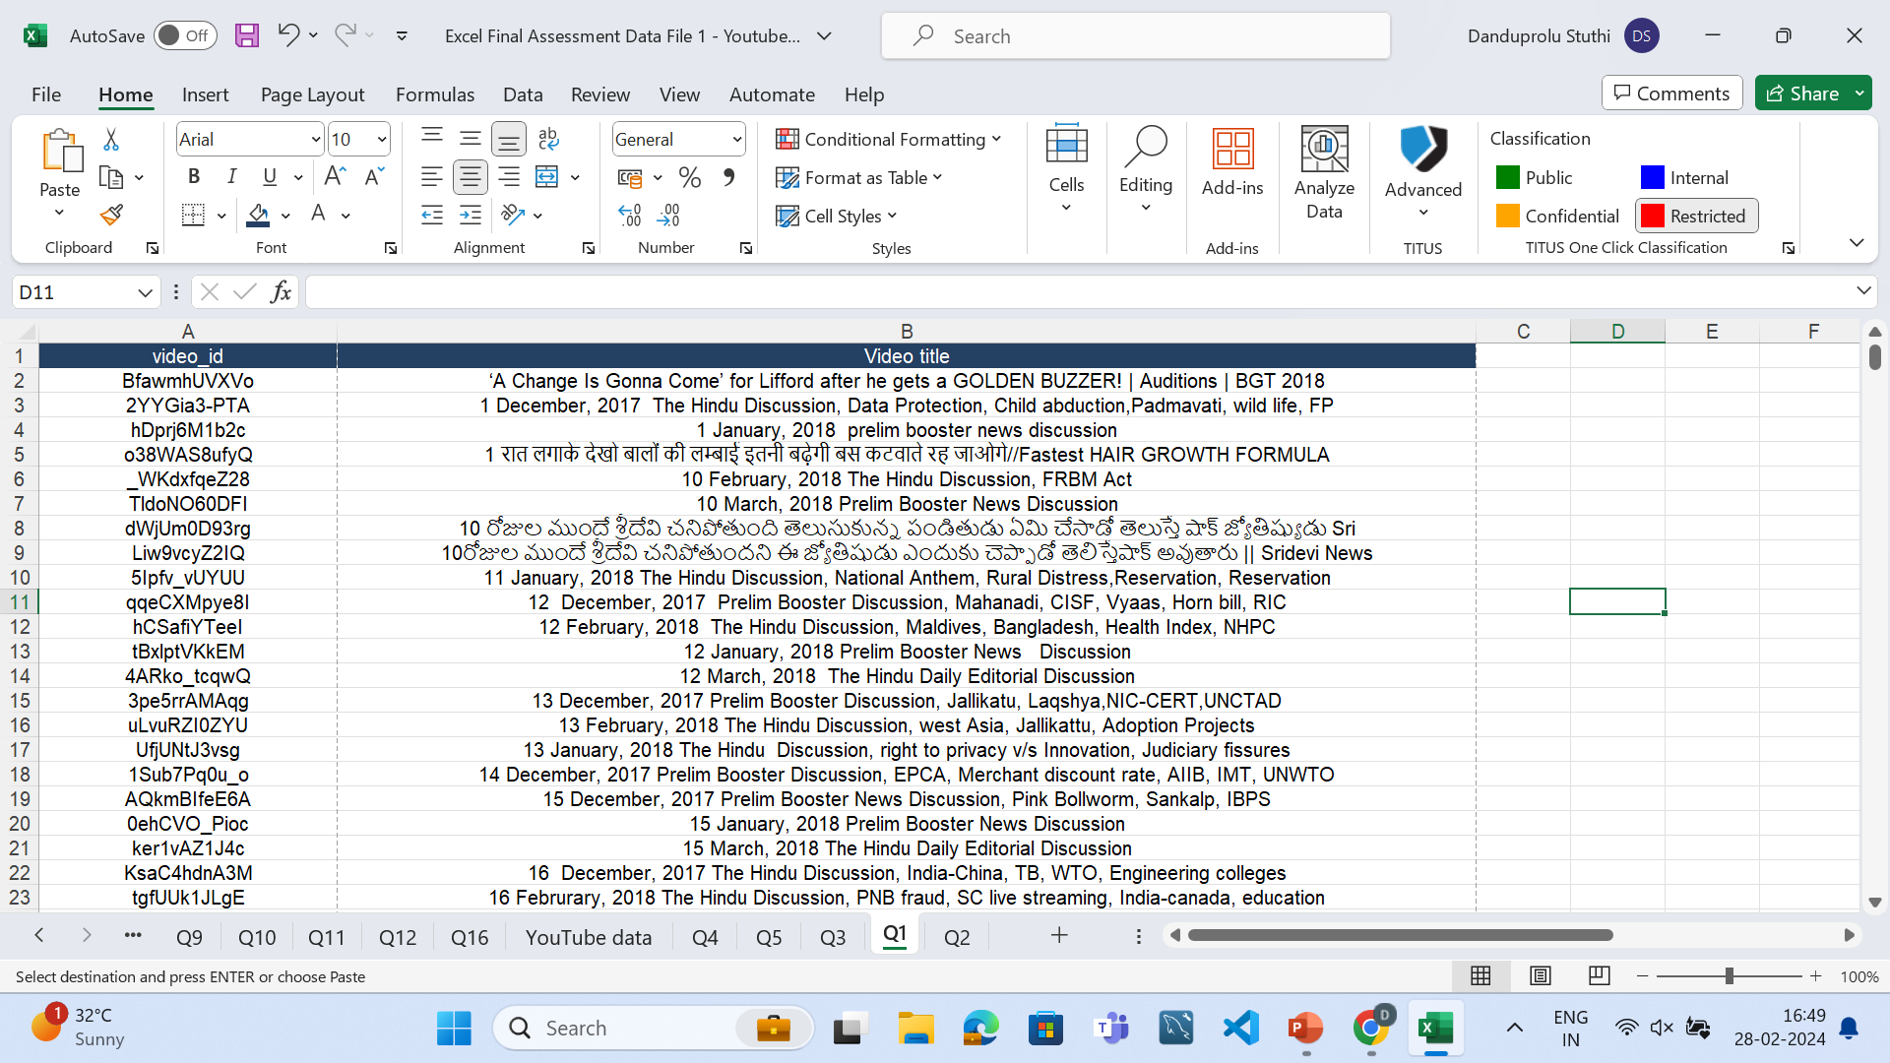
Q1-Data Cleaning
Removed Duplicate values and remaining Data

Slide 3
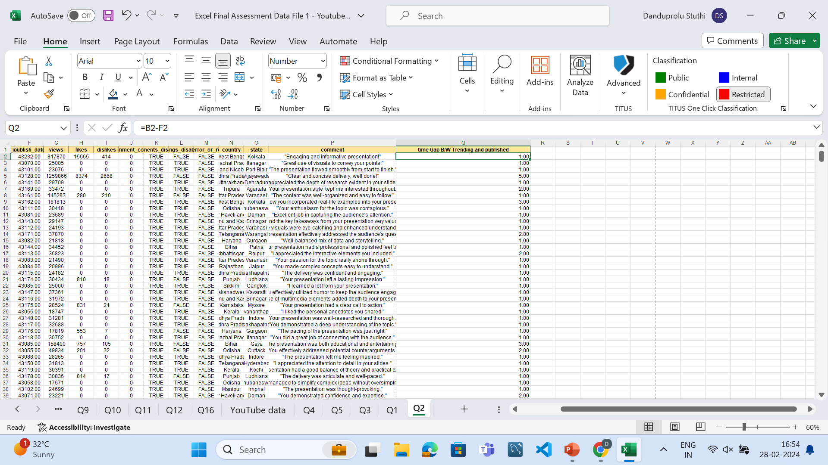
Q2-Time Analysis
Average gap b/w publish day and trending day 2.221284

Slide 4
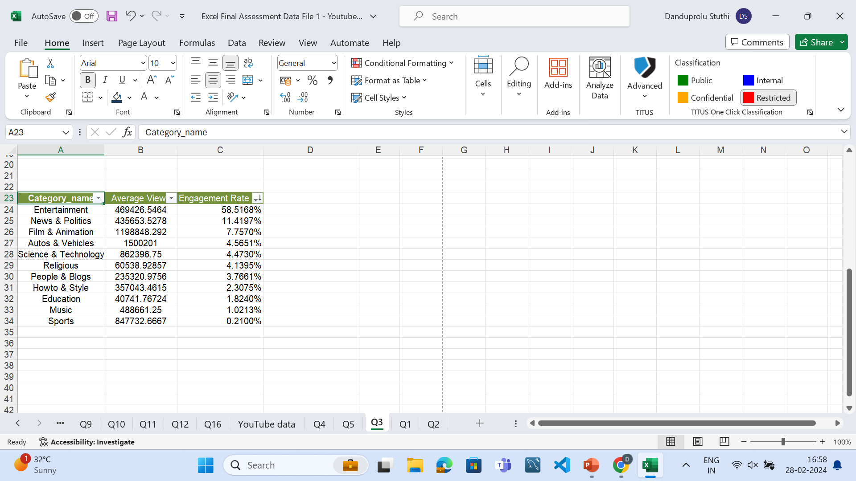
Q3-Catogory Analysis
formulas used =SUMIF('YouTube data'!Q:Q,'Q3'!A4,'YouTube data'!H:H)/1198274,AVERAGEIF('YouTube data'!Q:Q,'Q3'!A3,'YouTube data'!G:G), and Xlookup formula
Highest Engagement Rate is for Entartainment

Slide 5
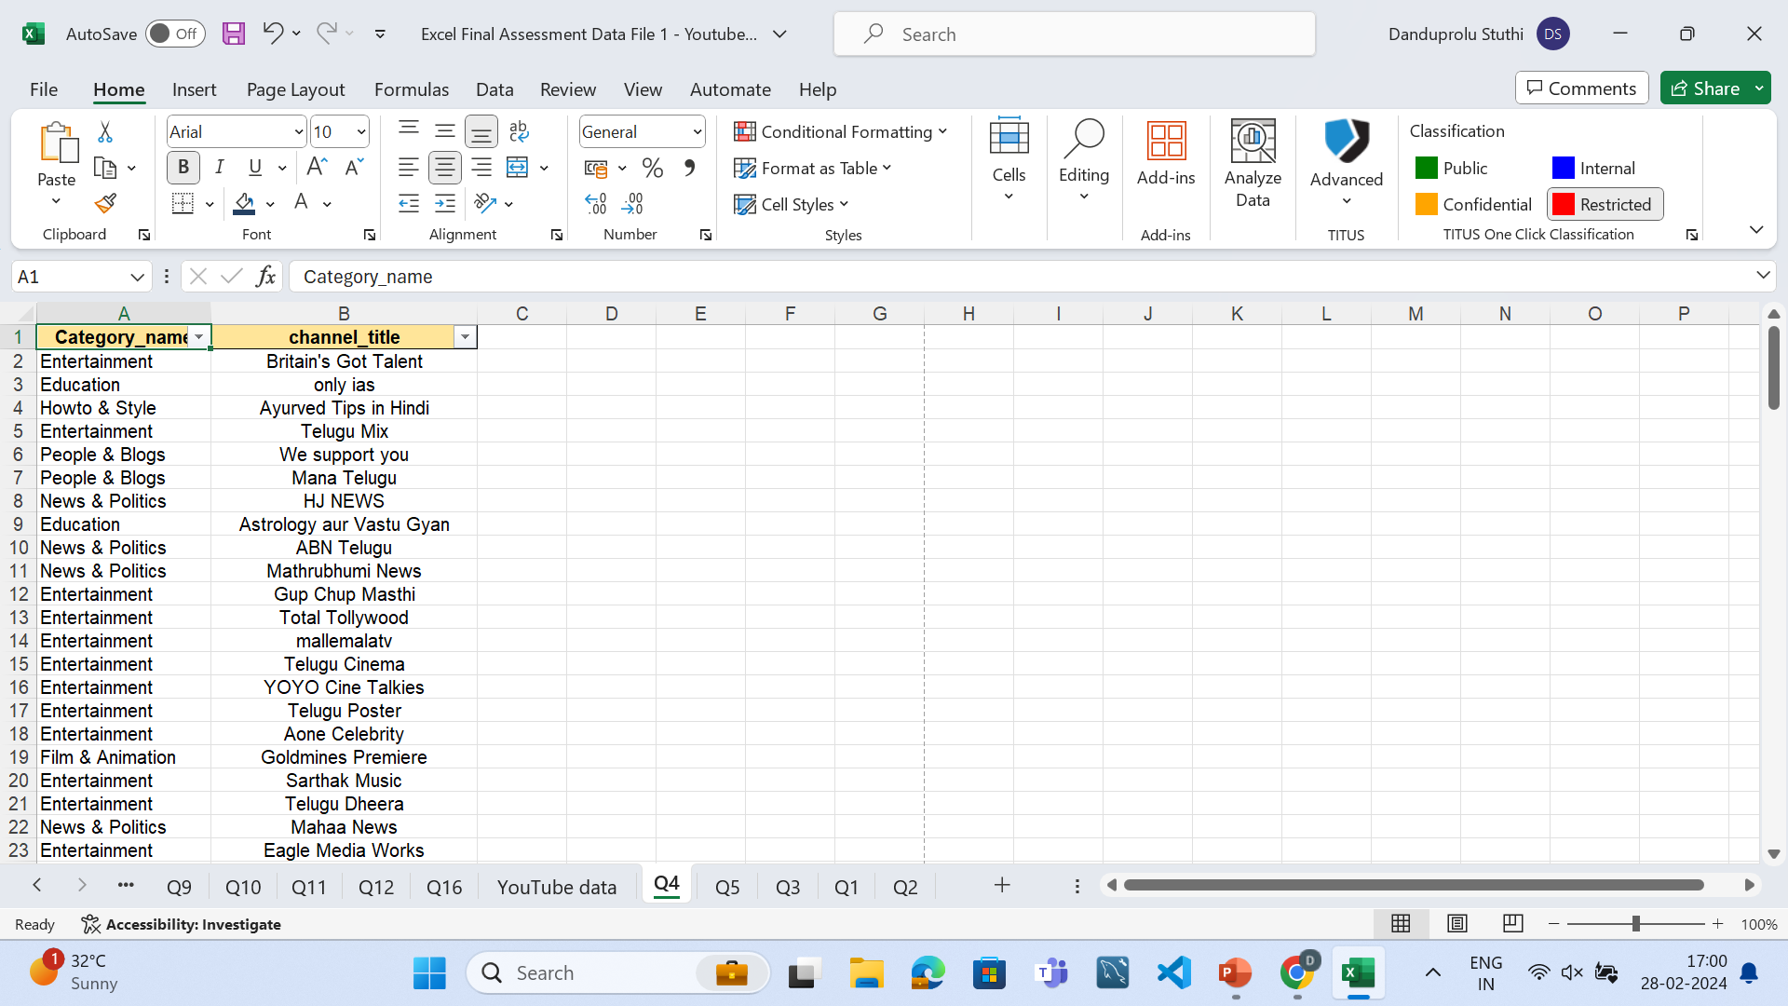
Q4-Filter & Xlookup
Used Xlookup and filter formula
We got the specific channel name on specific catogory

Slide 6
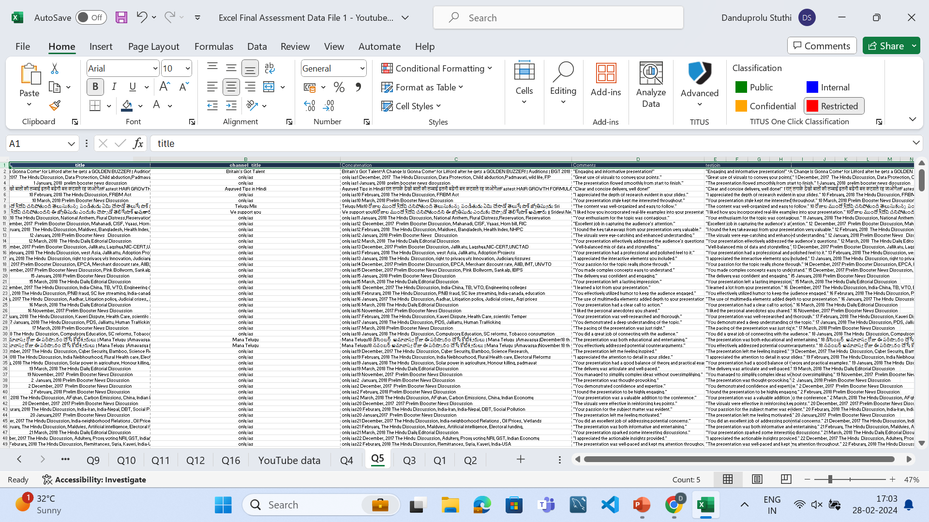
Q5-Text Analysis
Using textjoin and Concat we counld able to do Sentiment Analysis

Slide 7
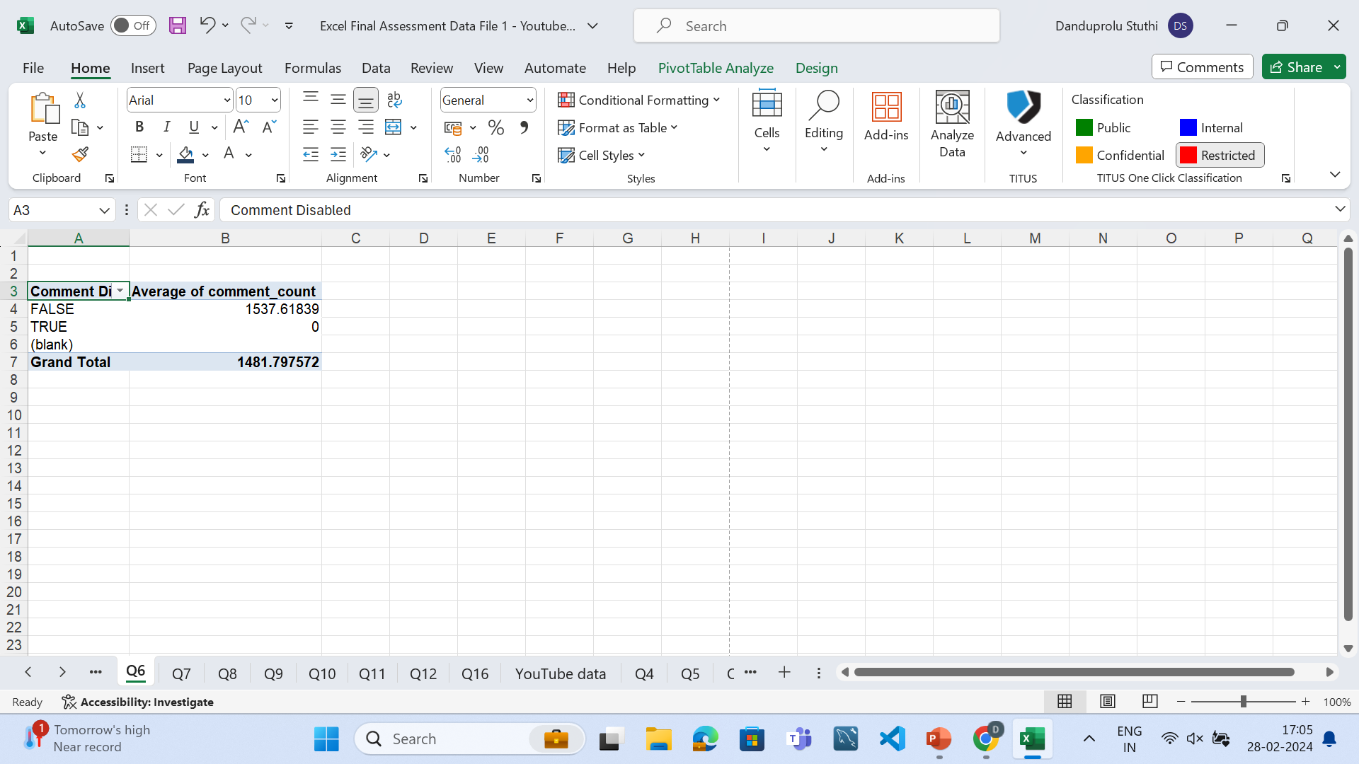
Q6-Comments Analysis
Used pivot table
The average comments are 1481.797572

Slide 8
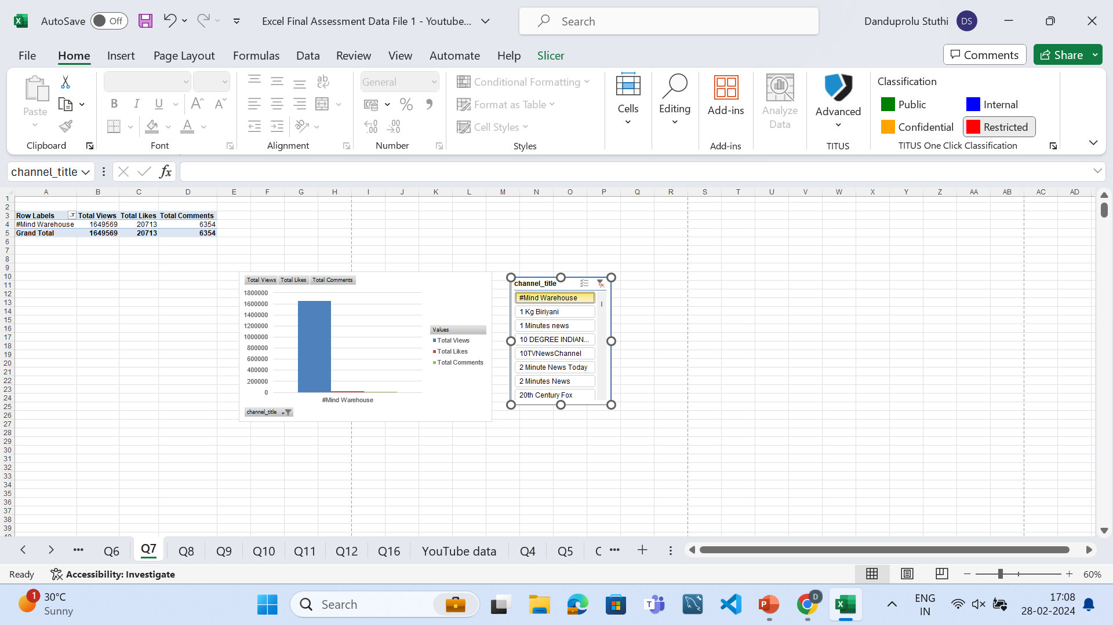
Q7-Visual Creation
Obtained the visual Creation for specific channel

Slide 9
Q8-Top 5 Bottom 5
Row Labels | Sum of views | Sum of likes | Sum of comment_count | Engagement Rate
1 December, 2017 The Hindu Discussion, Data Protection, Child abduction,Padmavati, wild life, FP | 25005 | 0 | 0 | 0
1 January, 2018 prelim booster news discussion | 23076 | 0 | 0 | 0
10 February, 2018 The Hindu Discussion, FRBM Act | 29709 | 0 | 0 | 0
10 March, 2018 Prelim Booster News Discussion | 33472 | 0 | 0 | 0
10రోజుల ముందే శ్రీదేవి చనిపోతుందని ఈ జ్యోతిషుడు ఎందుకు చెప్పాడో తెలిస్తేషాక్ అవుతారు || Sridevi News | 161813 | 0 | 0 | 0
11 January, 2018 The Hindu Discussion, National Anthem, Rural Distress,Reservation, Reservation | 30418 | 0 | 0 | 0
12 December, 2017 Prelim Booster Discussion, Mahanadi, CISF, Vyaas, Horn bill, RIC | 23689 | 0 | 0 | 0
Row Labels | Sum of views | Sum of likes | Sum of comment_count | Engagement Rate
YouTube Rewind: The Shape of 2017 | #YouTubeRewind | 1.25E+08 | 2912710 | 807558 | 25.13338
Marvel Studios' Avengers: Infinity War Official Trailer | 89930713 | 2606663 | 347982 | 19.96099
Taylor Swift - End Game ft. Ed Sheeran, Future | 42019590 | 1804377 | 146917 | 13.18255
Ed Sheeran - Perfect (Official Music Video) | 39082222 | 1721384 | 90352 | 12.23972
Taylor Swift - Delicate | 43738208 | 1658756 | 148548 | 12.20978
Marvel Studios' Avengers: Infinity War - Official Trailer | 45064699 | 1494997 | 186005 | 11.35651

Slide 10
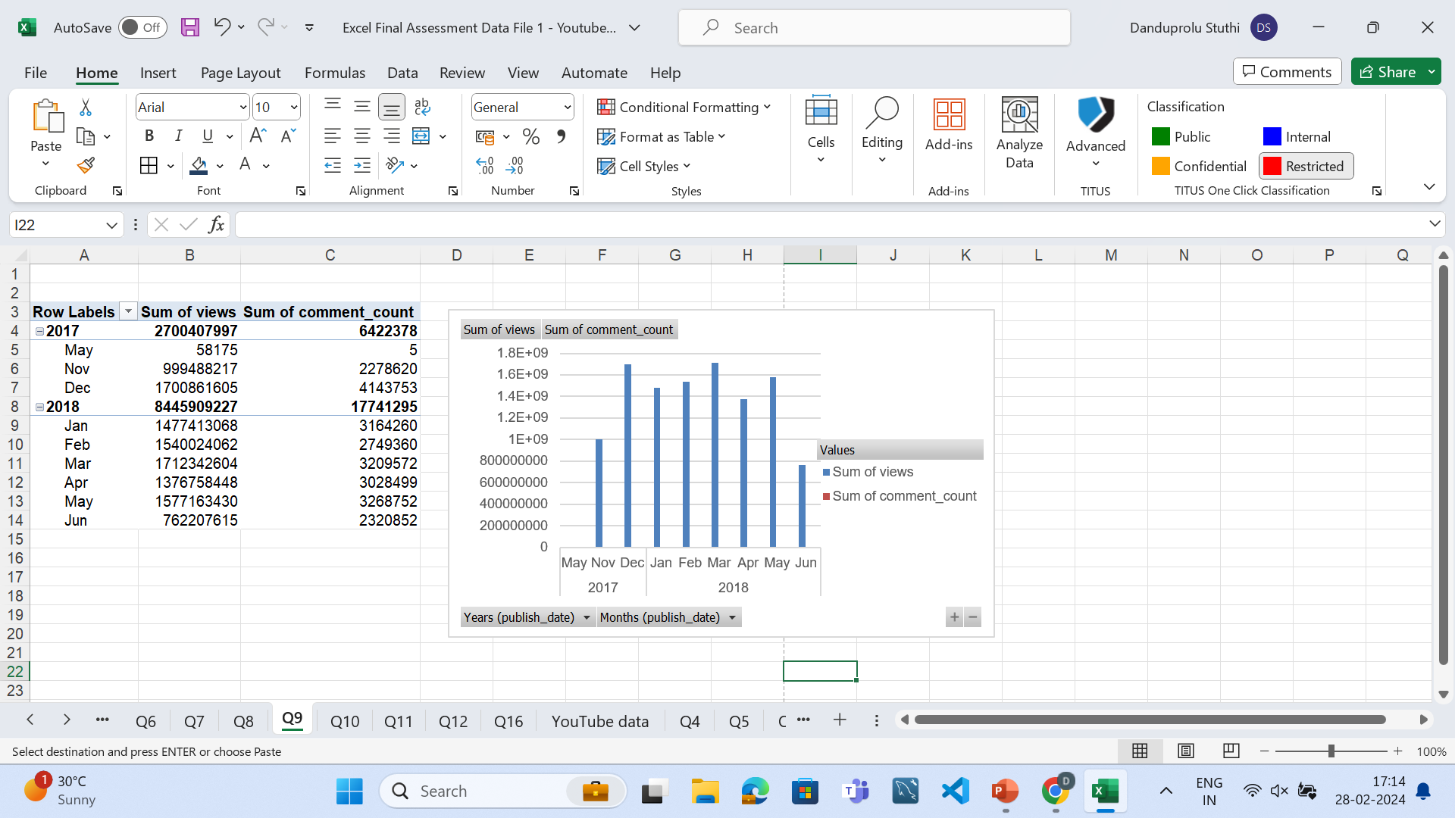
Q9-Filtering by Conditions
Views Are less on specific months like June and high on months like december

Slide 11
Q10-Growth Analysis
Growth is Good in 2017 compared to 2018

Slide 12
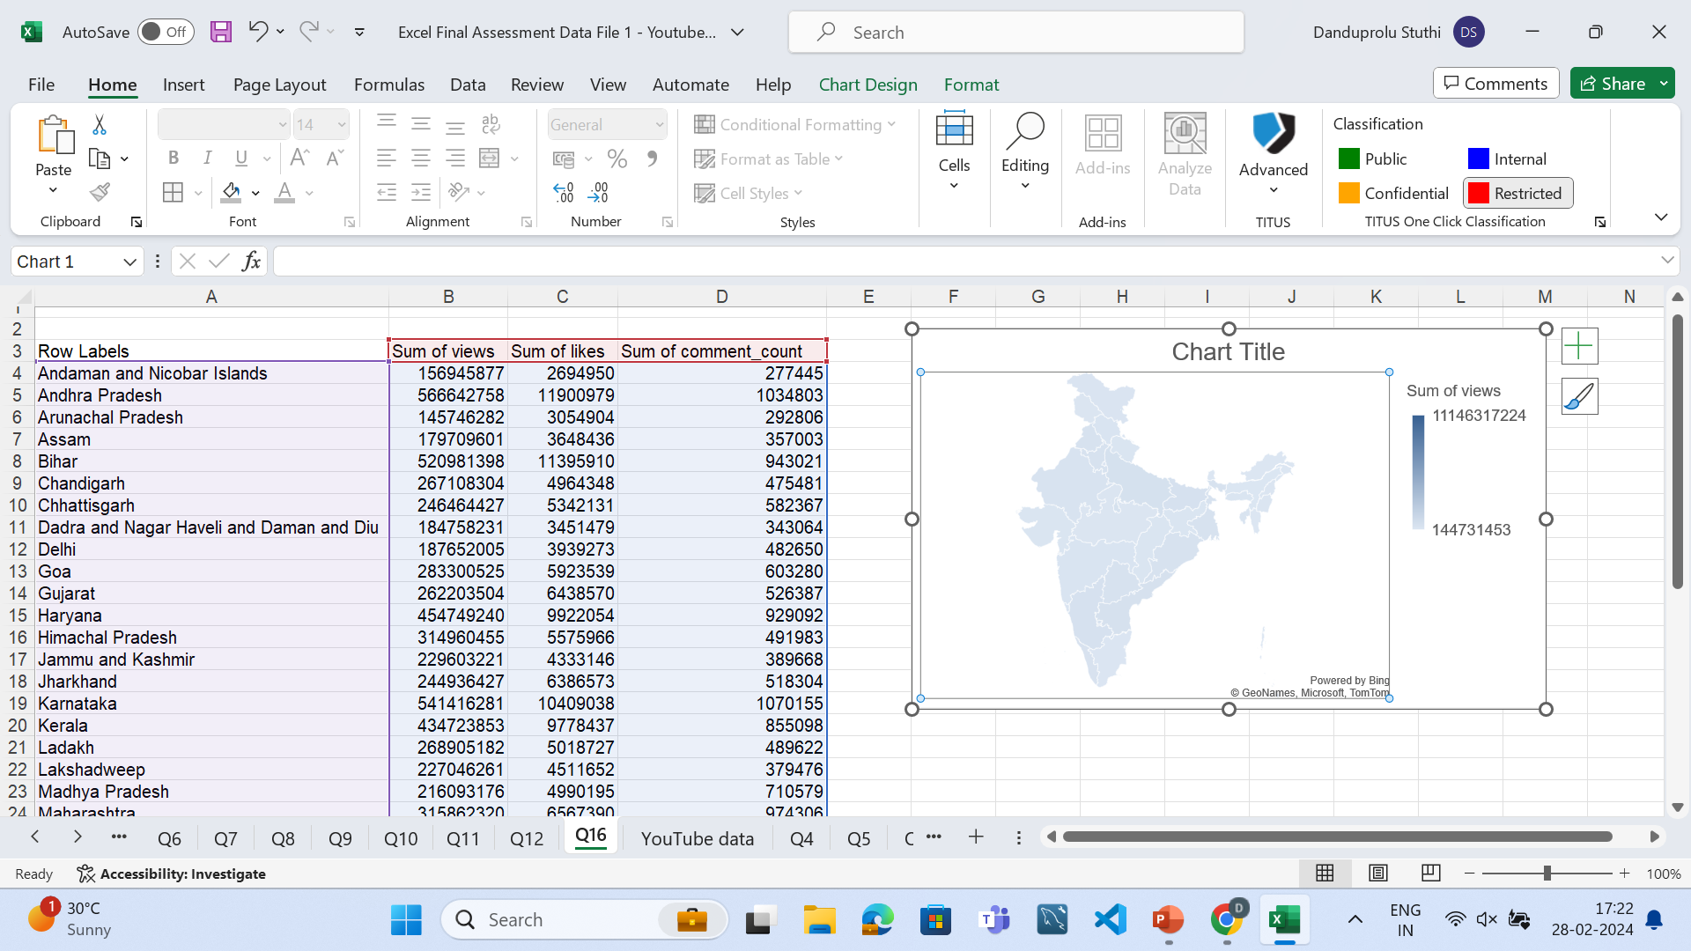
Q16-Geographic Analysis
Got Data According to the states

Slide 13
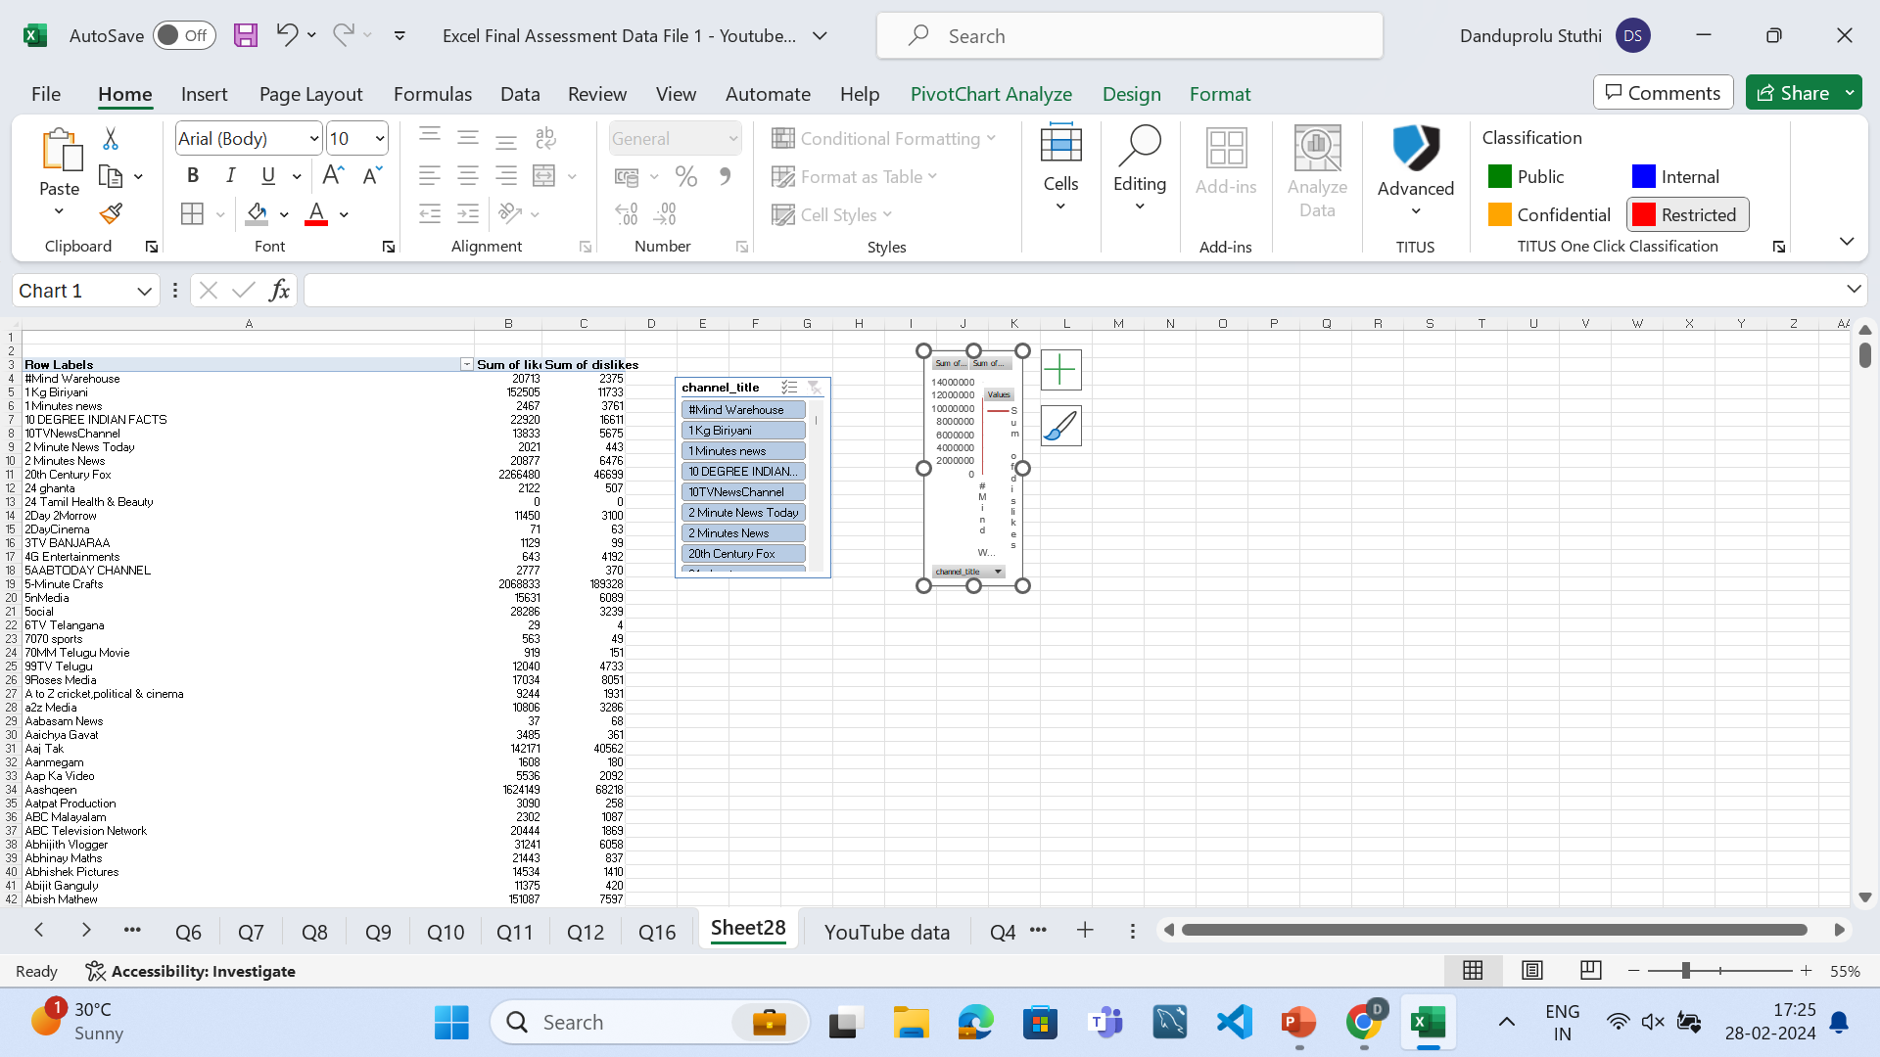
Q18-Trend Analysis

Slide 14
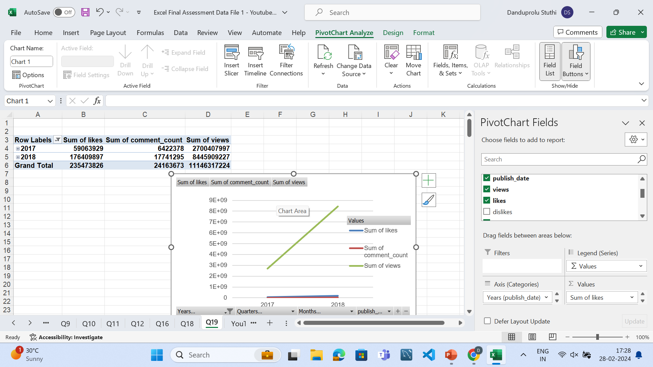
Q1-19-Growth Analysis

Slide 15
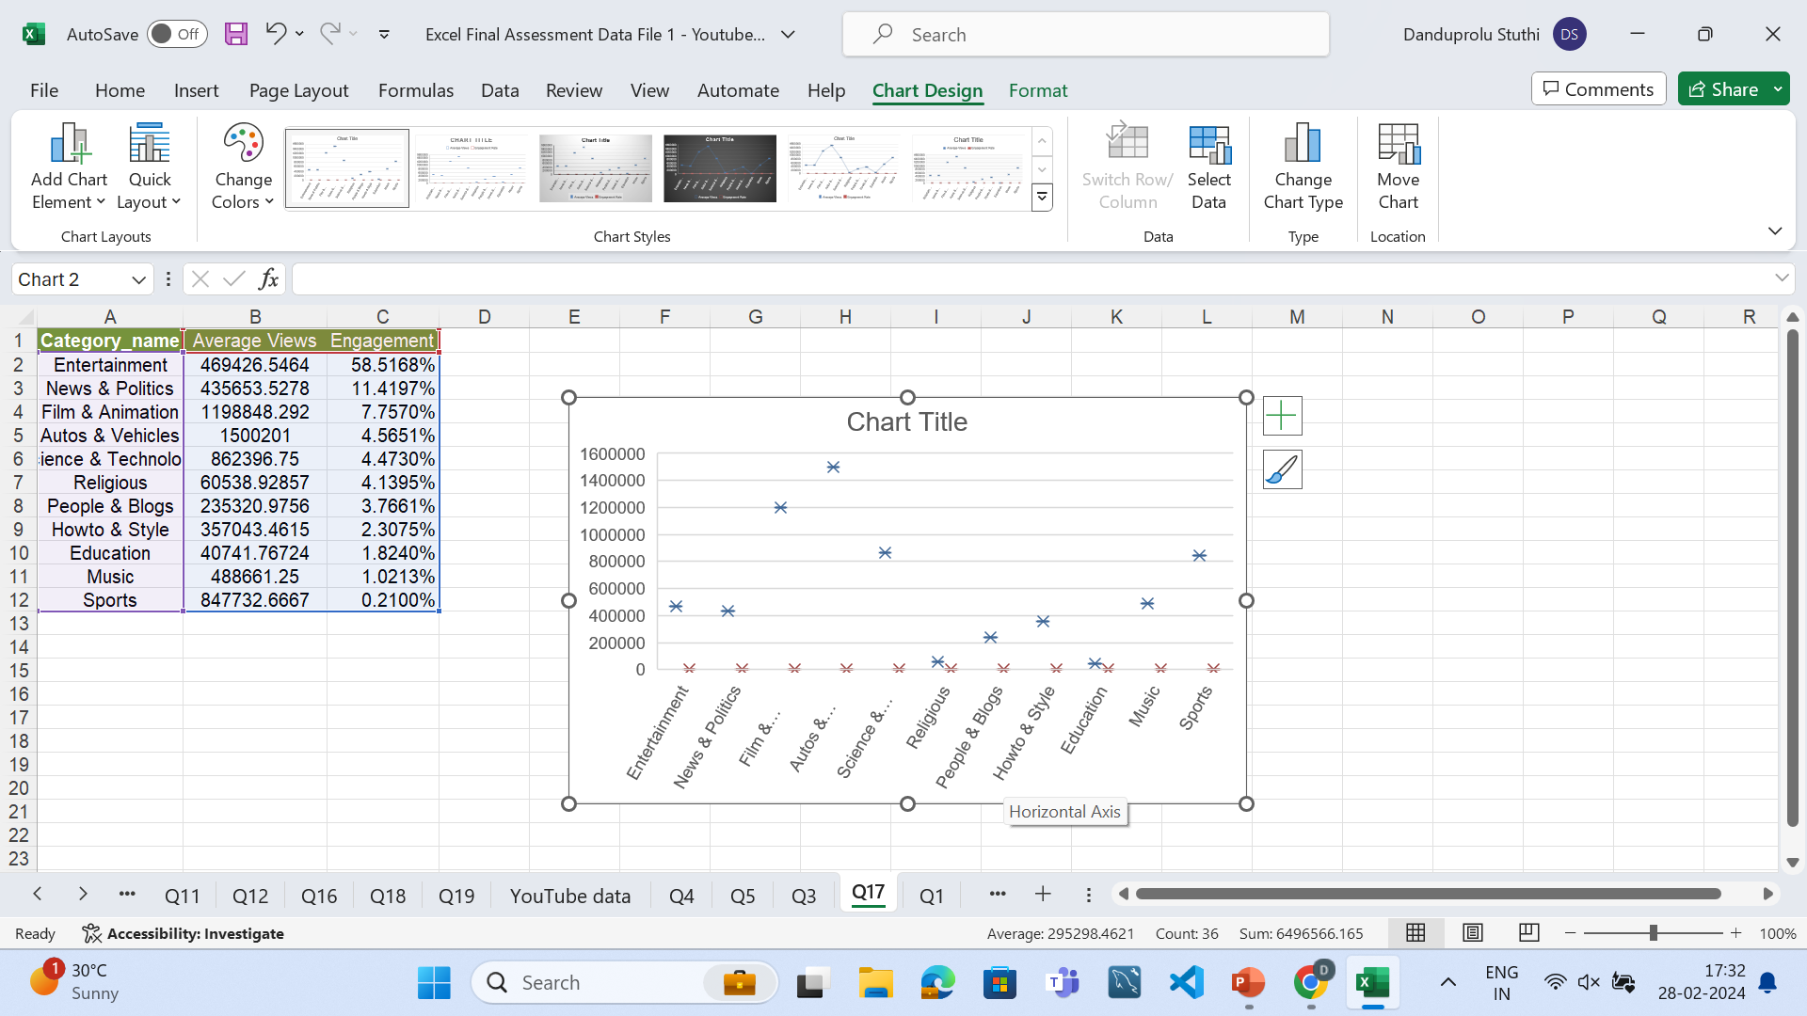
Q17-Outlier Detection

